Slide 1

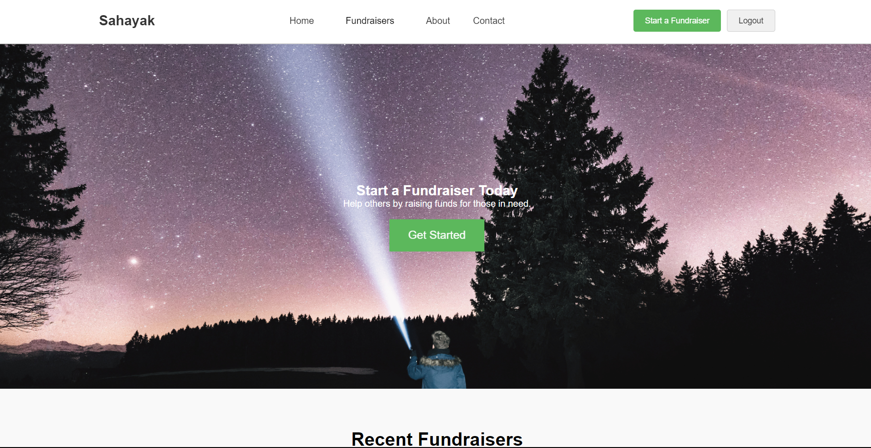
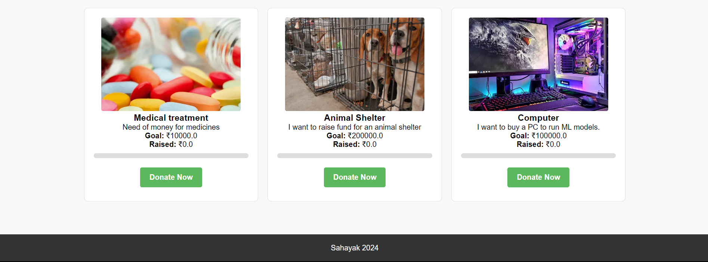
November 26, 2024
Sahayak
CS699 Course Project
Presented by:
Saurbh Singh Jamwal
(24m2132)

Slide 2
My Fundraisers
Payment
Donate
Fundraisers
created
View fundraisers
Create Fundraiser
Homepage
View Fundraisers
Create fundraiser
Yes
Logged in?
Logged in
No
Successful
User Authentication
Register
Not found
Log in

Slide 3
Technologies Used
Website: HTML, CSS, JavaScript
Frontend: Flask
Backend: SQLAlchemy used to interact with SQLite database
Payment: Razorpay API integration
Data Visualization: Pandas and Seaborn using Jupyter Notebook
Other libraries: Pillow for image processing on uploaded images.
Matplotlib and Seaborn for plotting
Smtplib for mail management
Tabulate for making tables

Slide 4
What’s the Need?
You never know when you might need help for what reason.
As a part of IITB community, we can look after each other in times of need.
This project was motivated by donation scanners I saw in my hostel for someone in need.
Work done by
Saurbh Singh Jamwal- All

Slide 5
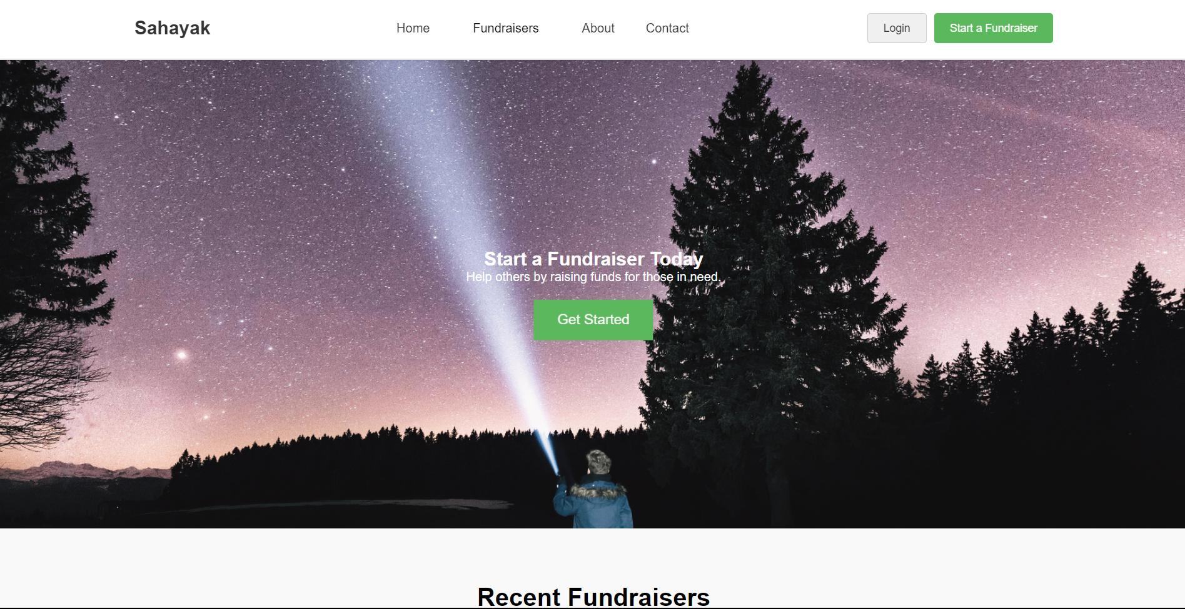
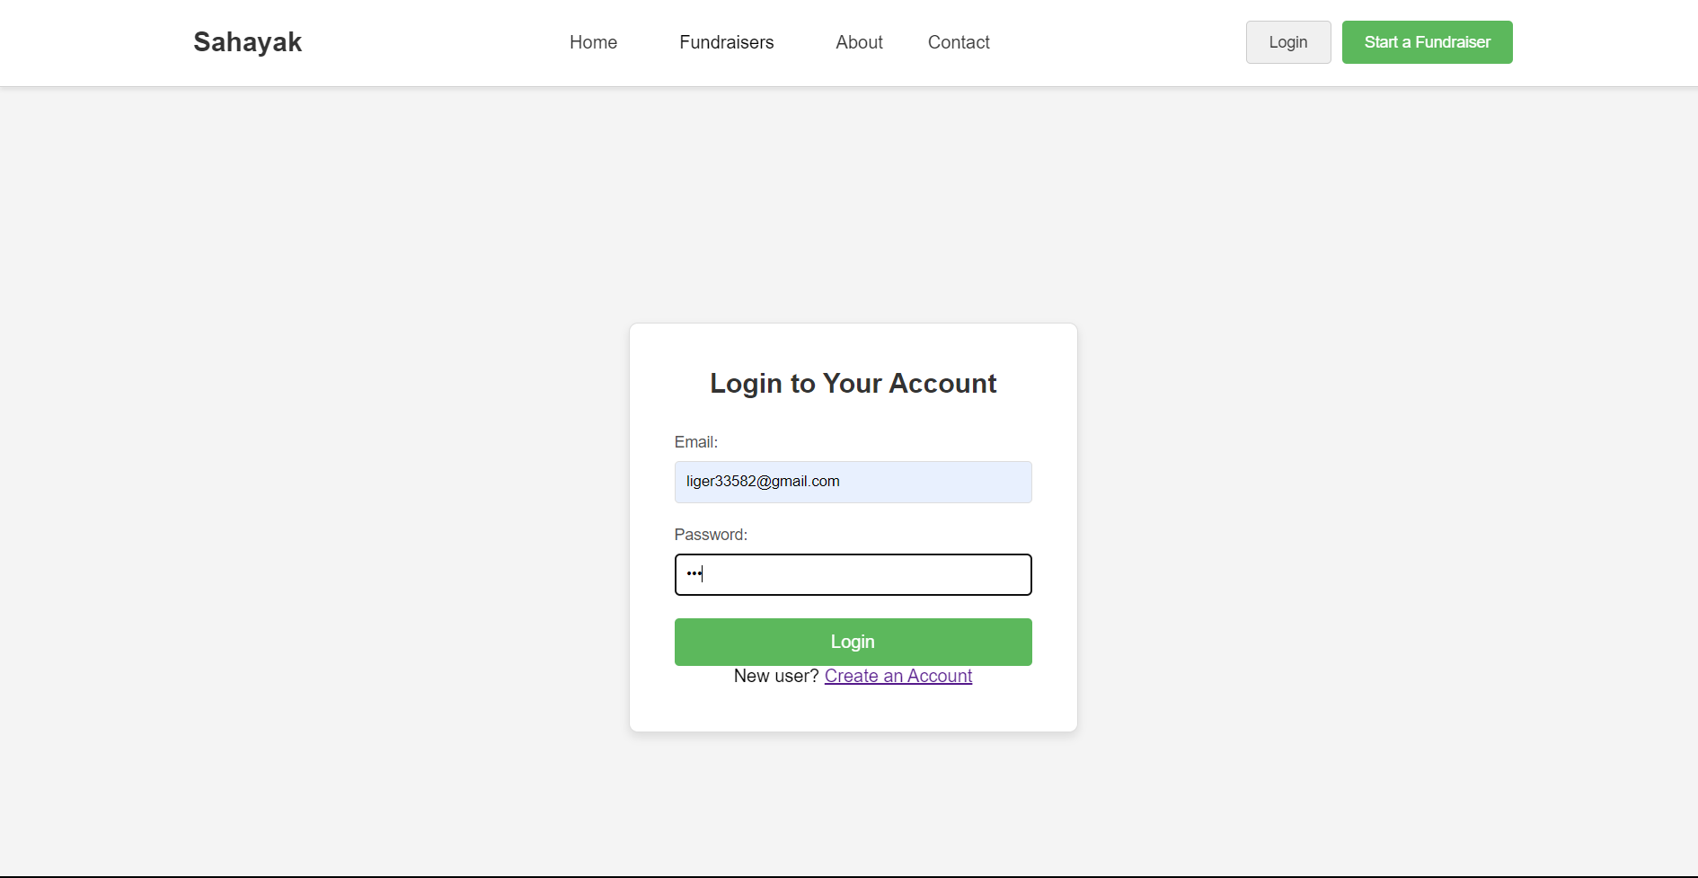
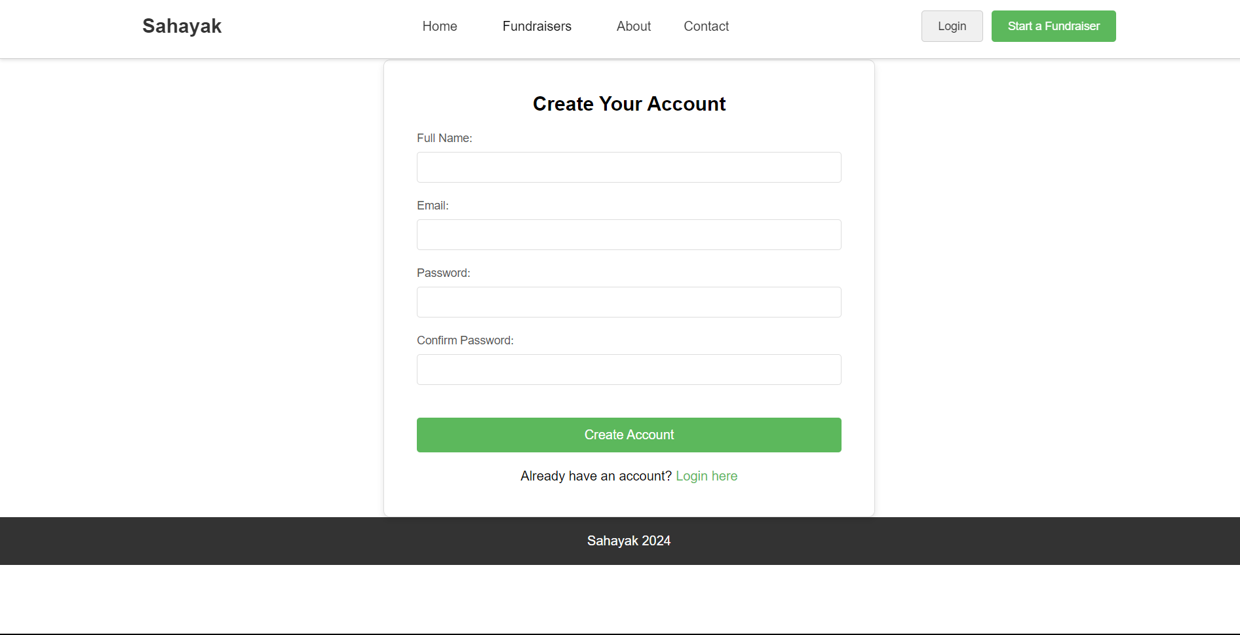
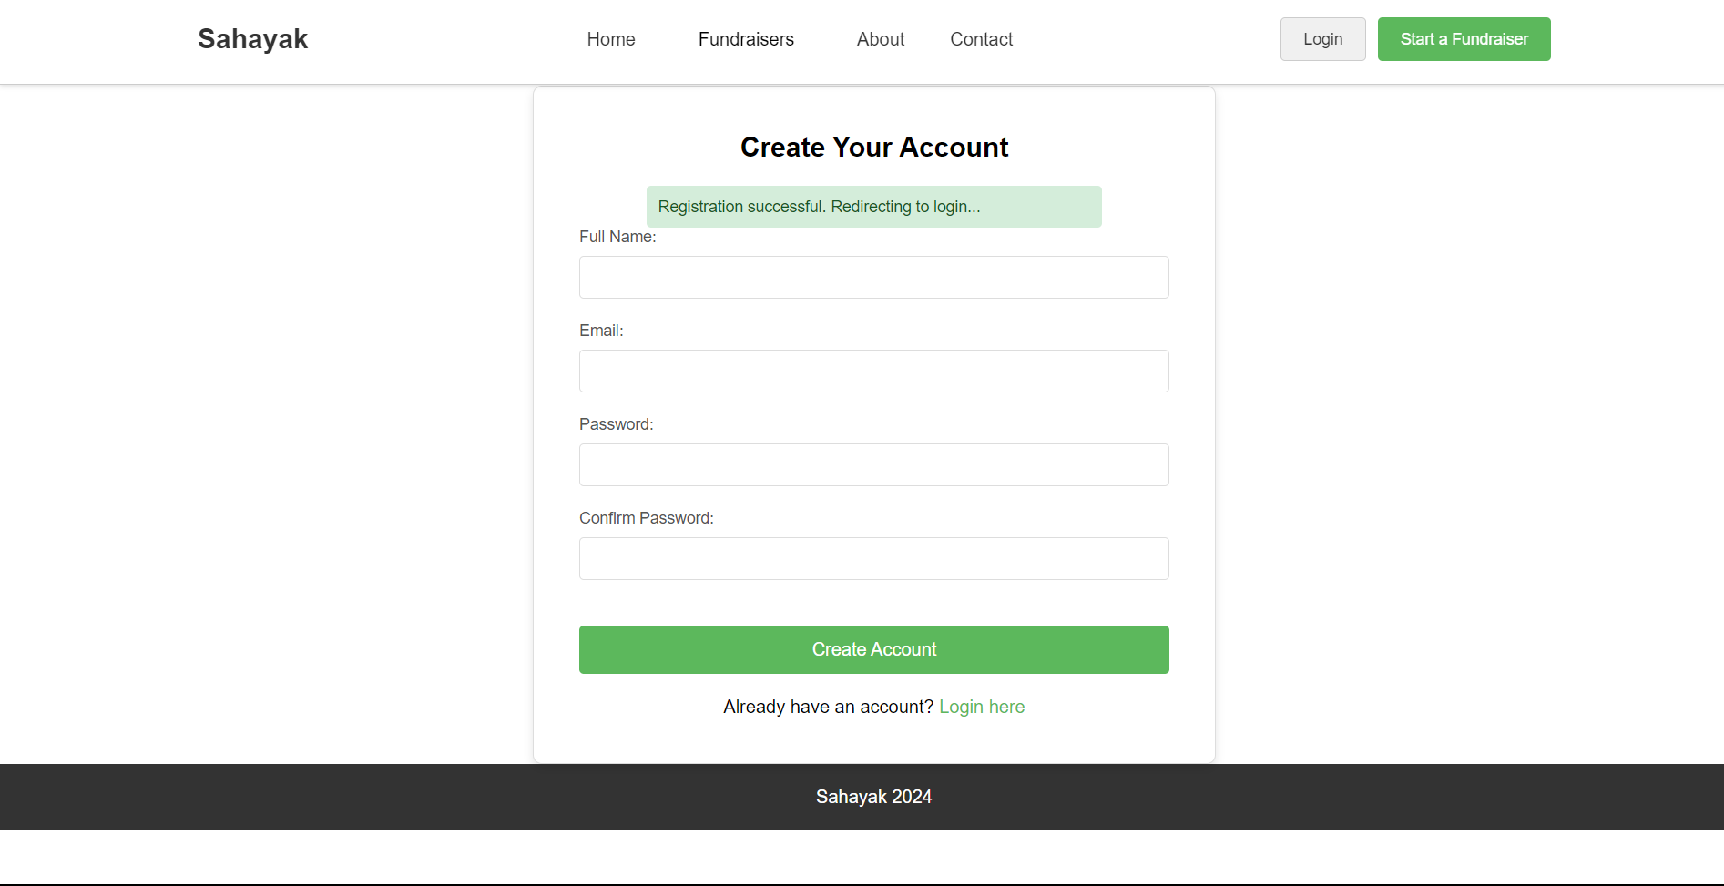
login

Slide 6
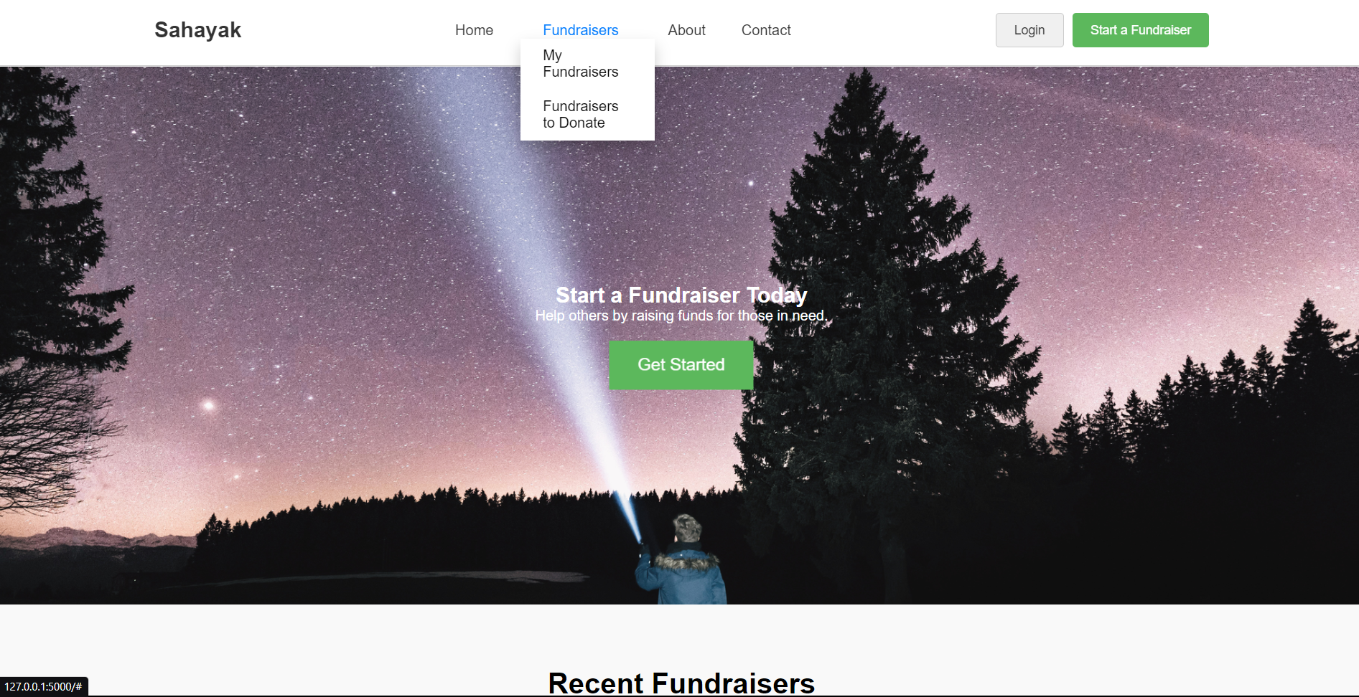
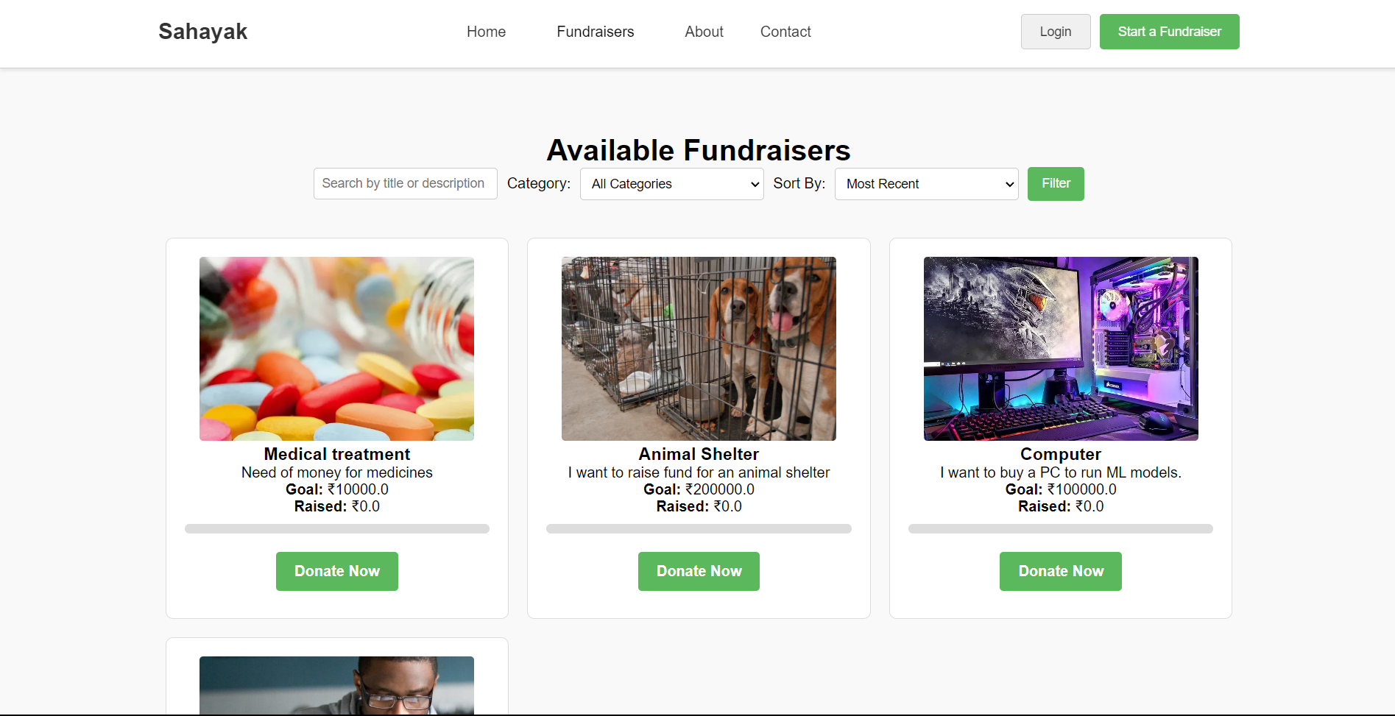
Notes:
View fundraisers

Slide 7
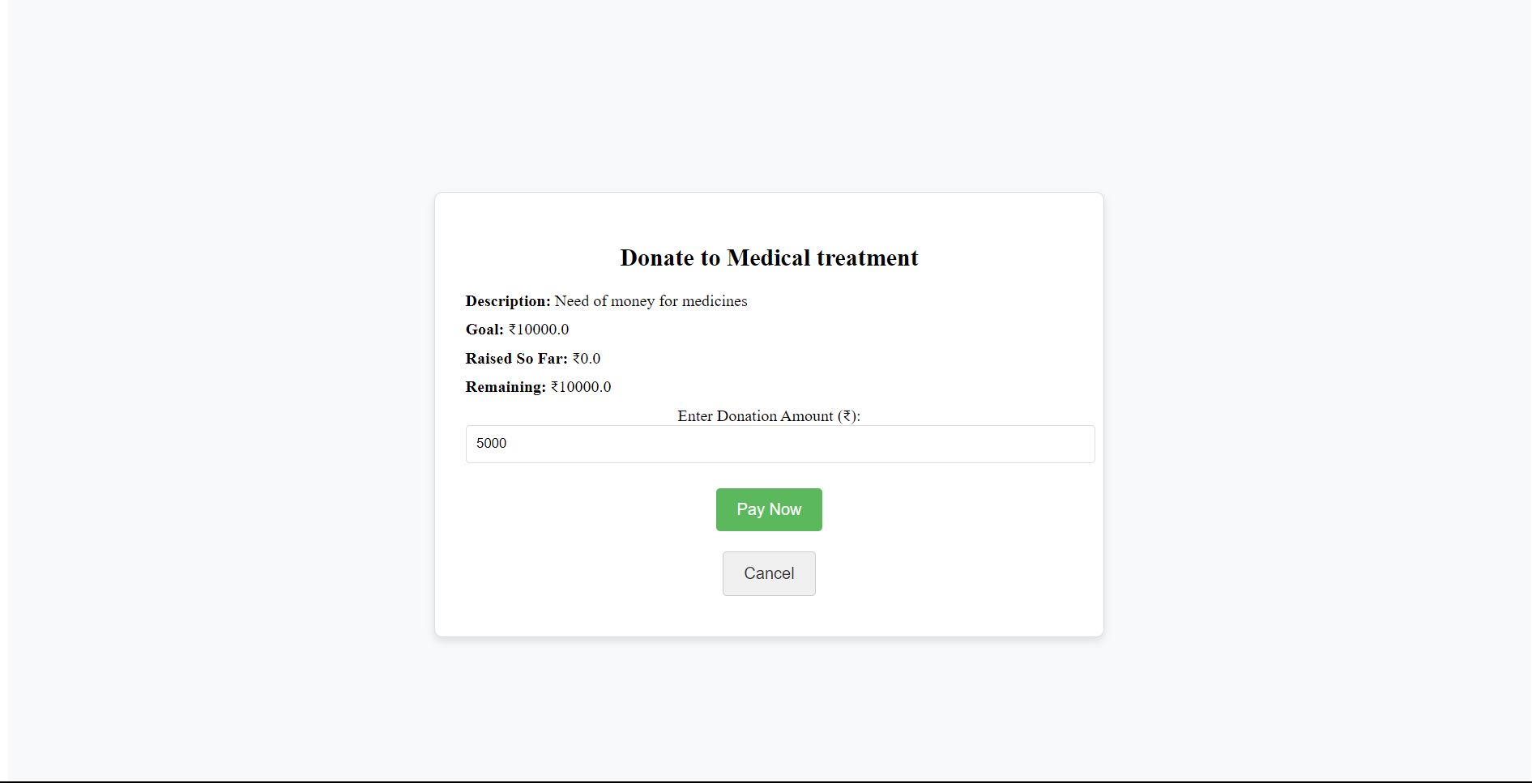
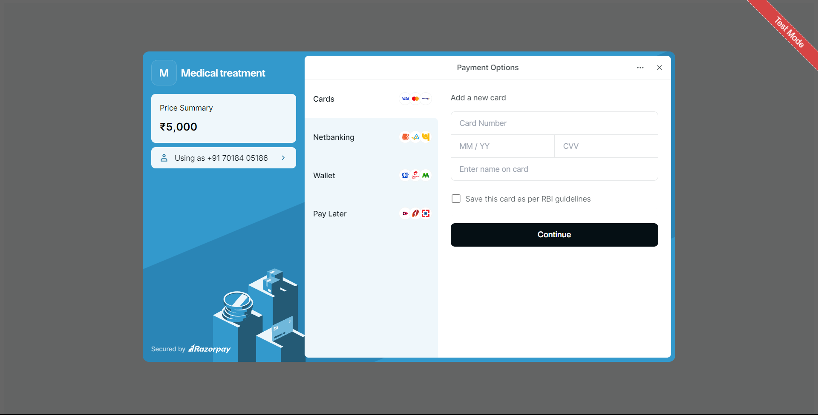
Notes:
Pay fundraisers

Slide 8
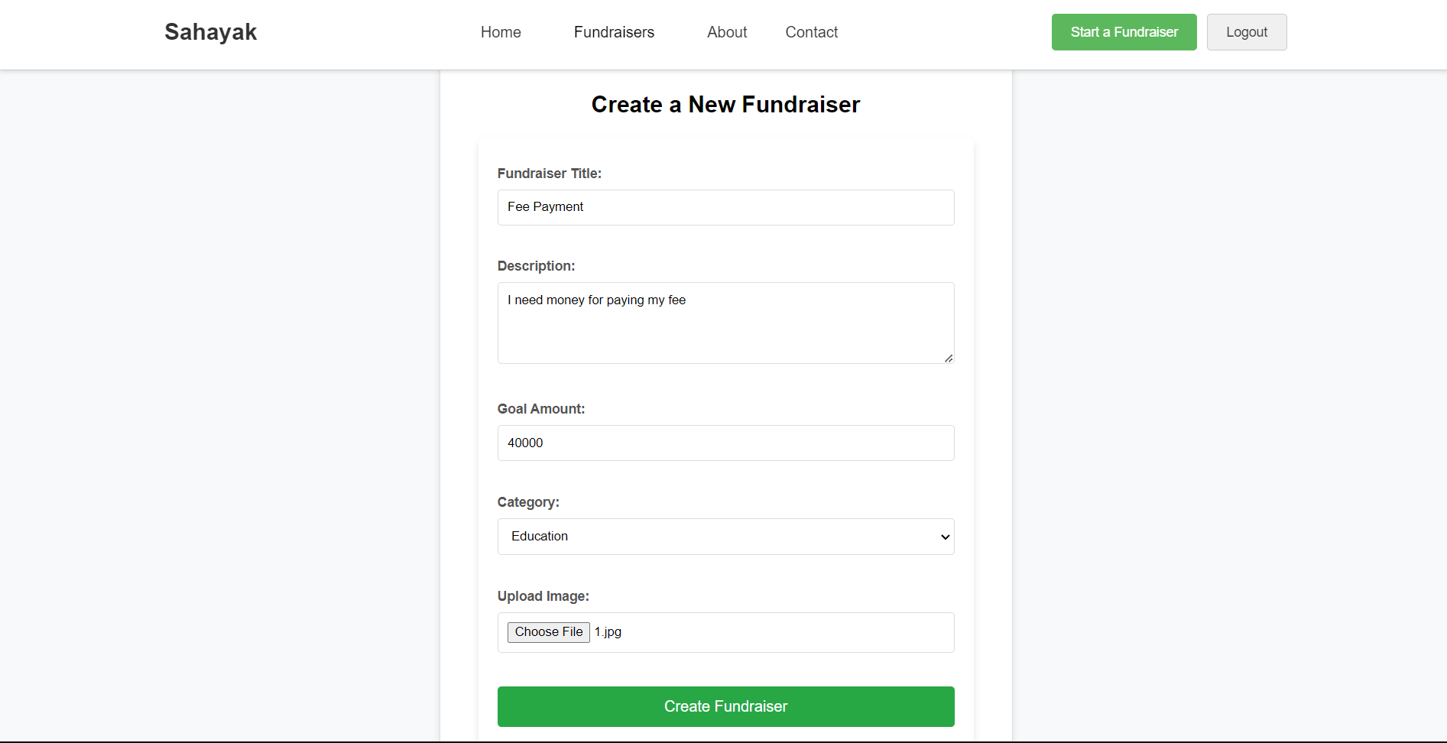
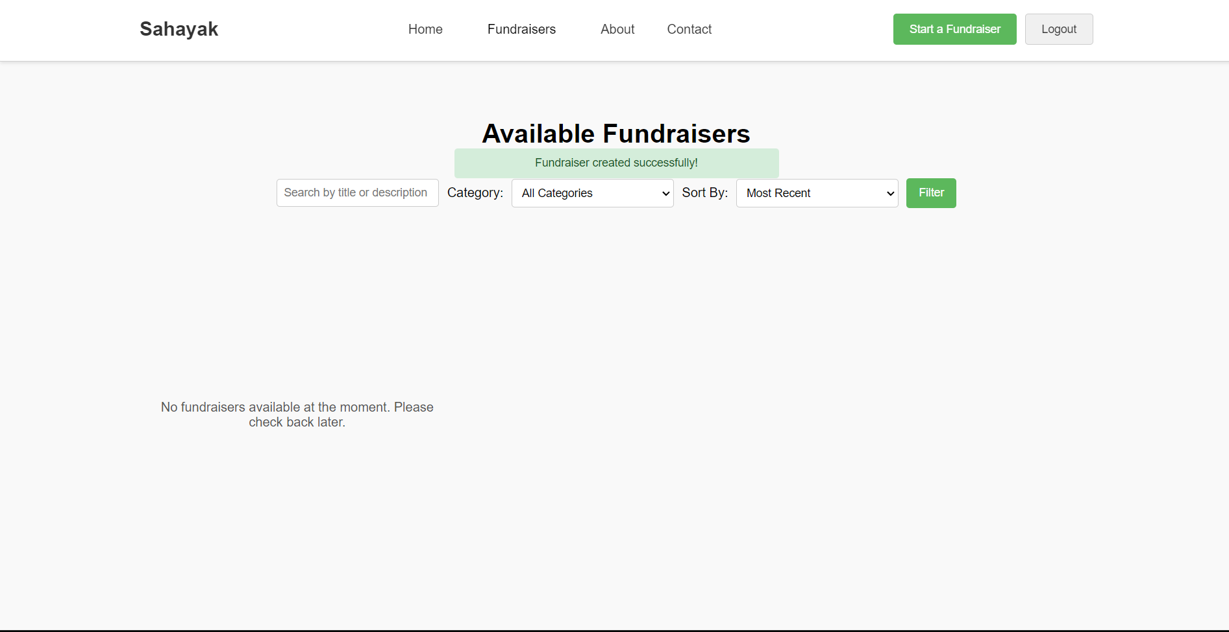
create fundraiser
View fundraiser
login
Notes:
Create fundraiser

Slide 9
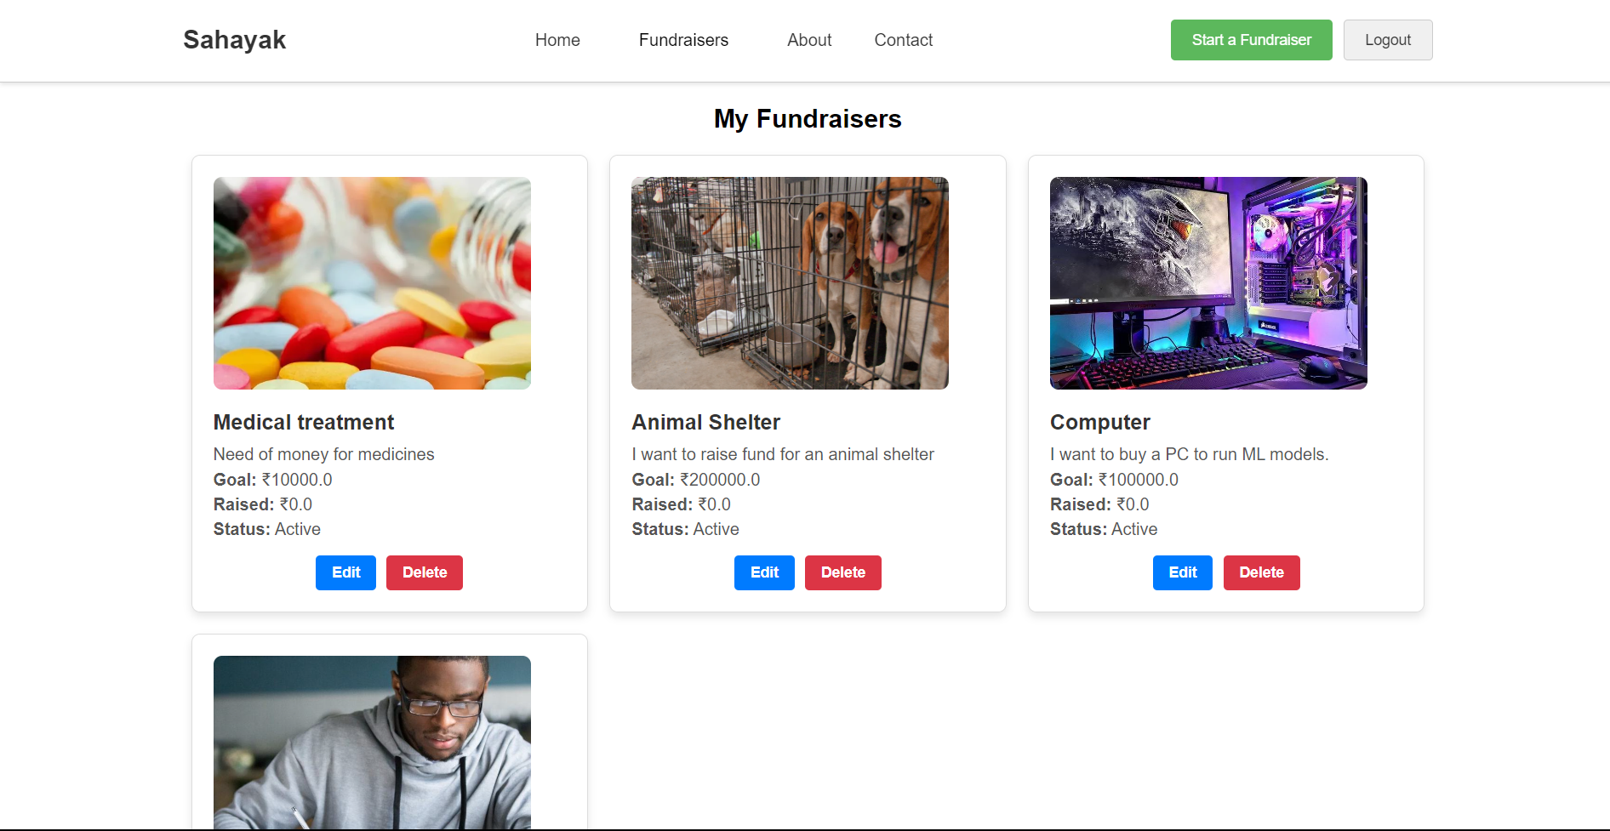
My fundraiser
create fundraiser
View fundraiser
login
Notes:
My fundraisers

Slide 10
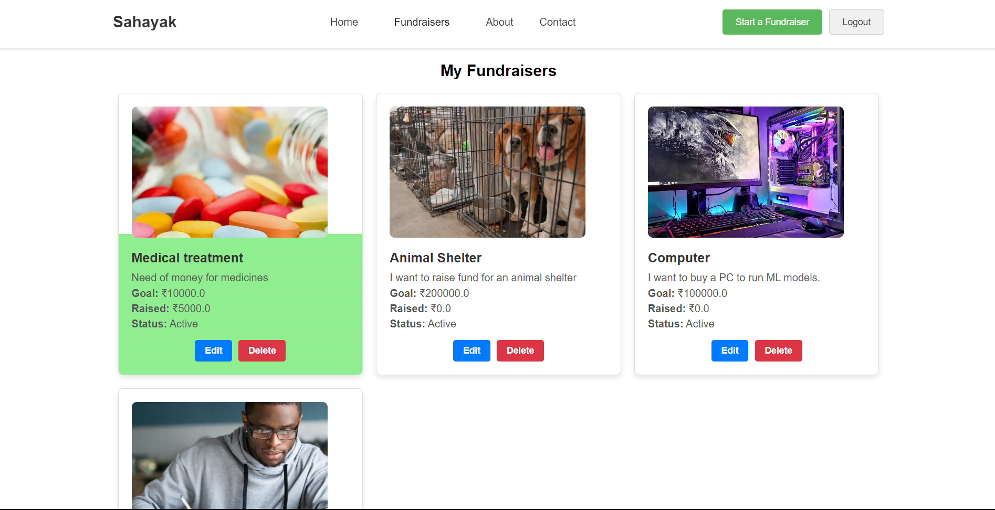
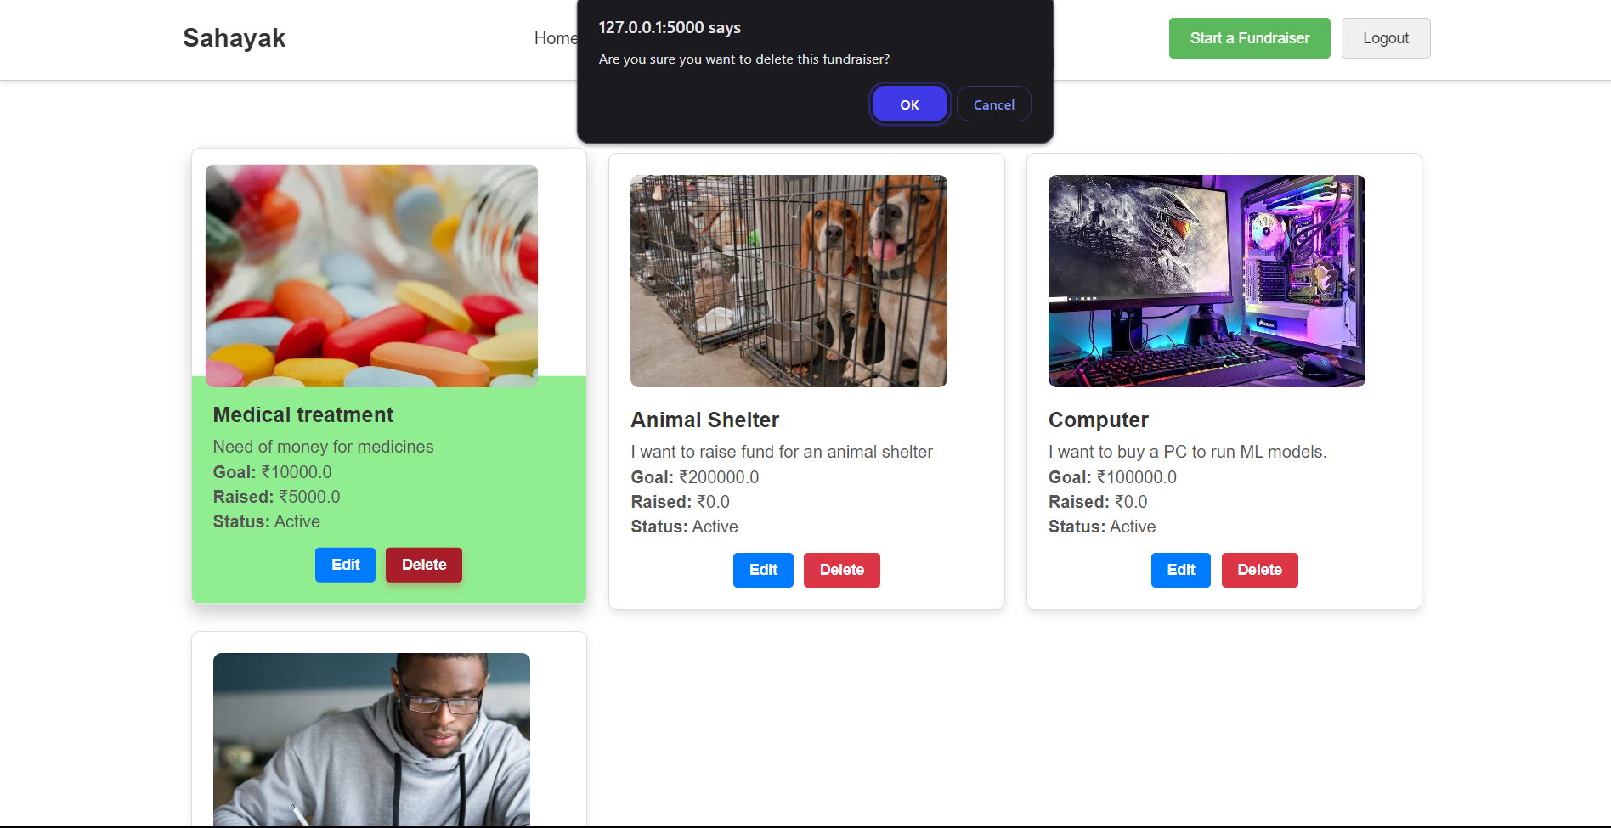
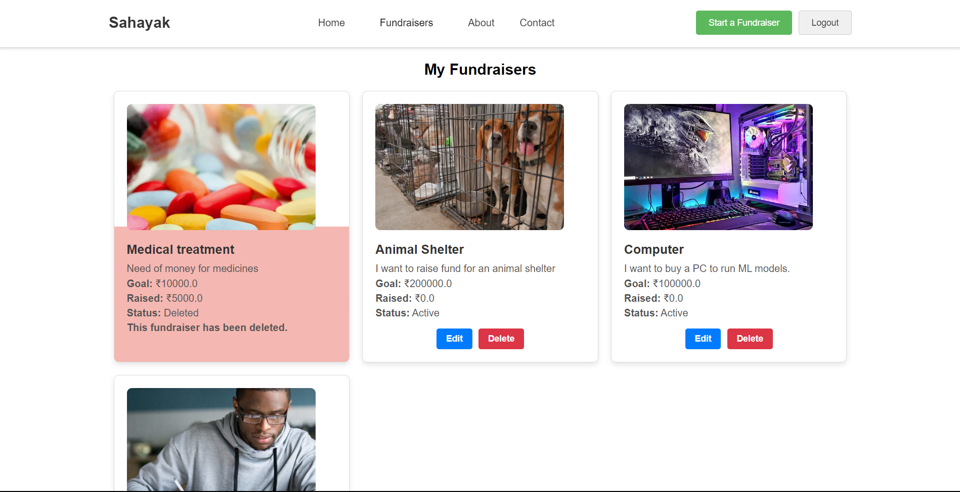
My fundraiser
create fundraiser
View fundraiser
Notes:
Delete fundraiser

Slide 11
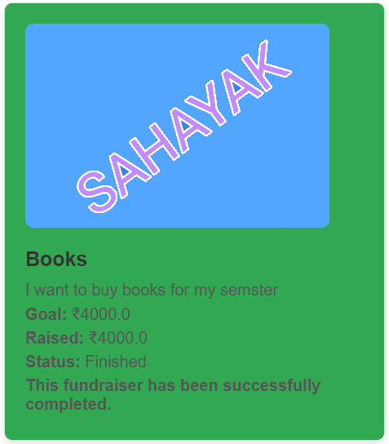
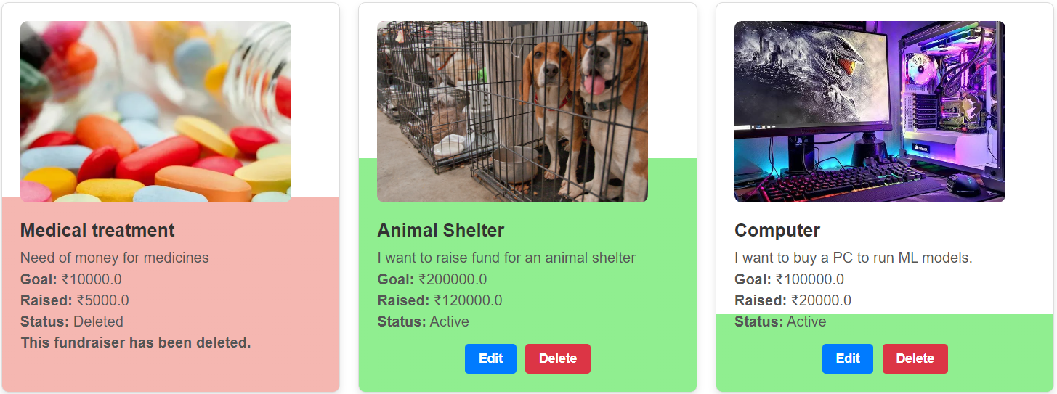
My Fundraisers

Slide 12
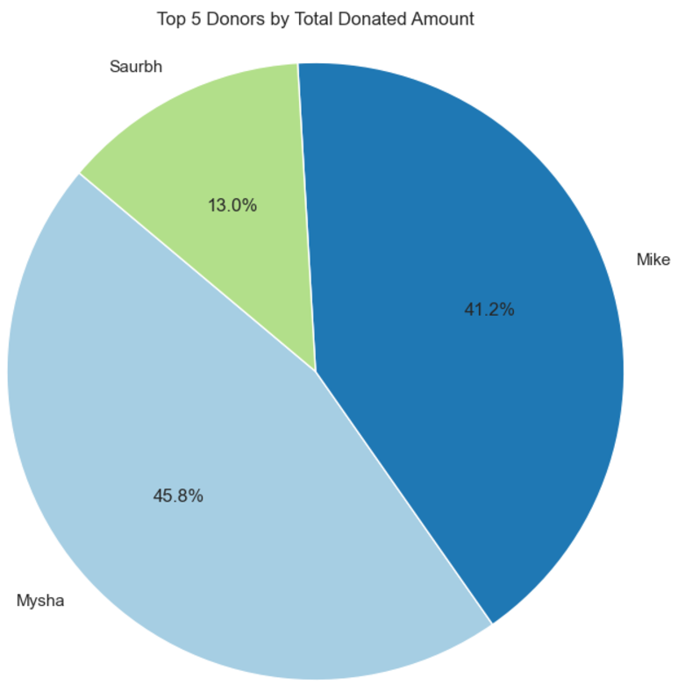
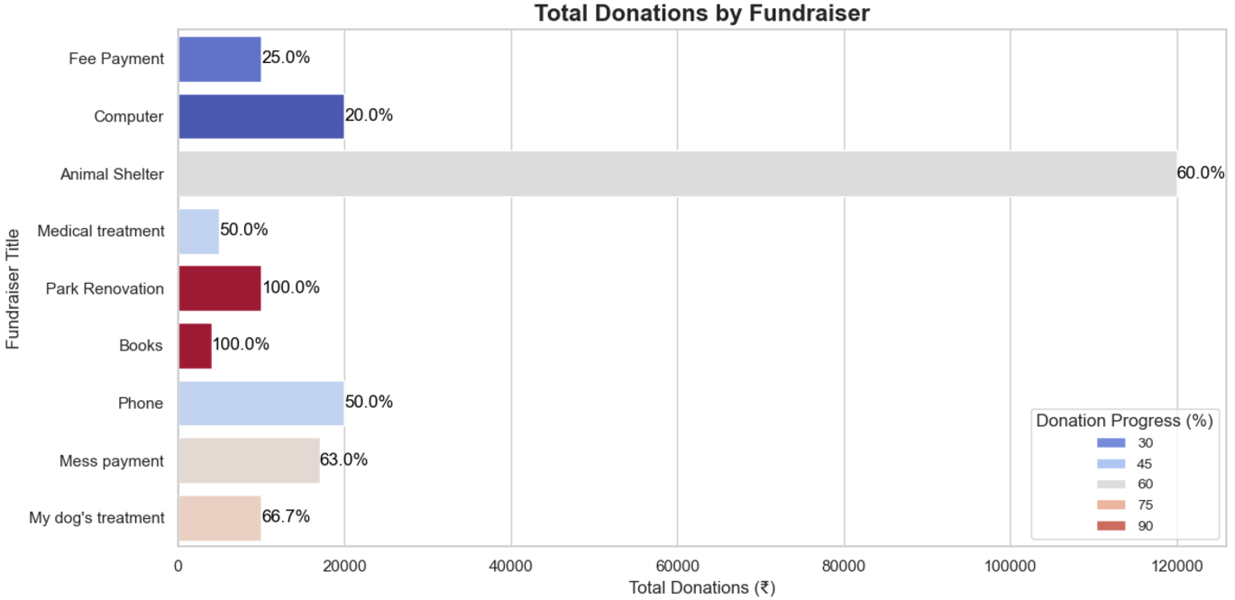
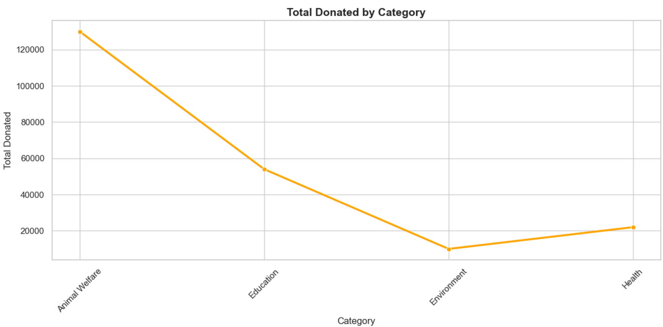


Slide 13
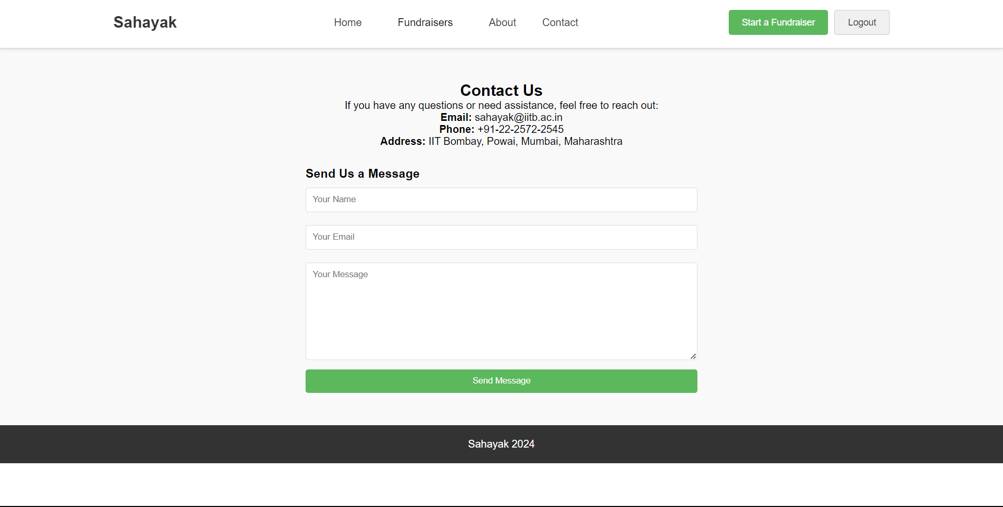

Slide 14
Problems Faced
Team Problems
My role was decided to be for frontend.
No progress or communication done by teammates when asked.
My work completely independent from them.
Made gradual progress since mid october, documented on Github.

Slide 15
Problems Faced
2. Payment Handling
The Pay Now button on the donation form was not functioning as expected, and Razorpay integration issues were encountered.
Debugged the Razorpay script for correct initialization and added necessary validations for user inputs.
Ensured the payment-success route was properly handling the Razorpay responses and updating the database.

Slide 16
Problems Faced
3. Classification of Fundraisers was needed
The “Fundraiser To Donate” tab should not show Fundraisers requested by the user.
For this a session id was created when you log in with your ID.
Another use was “My Fundraisers” tab that consists all of the user’s requested Fundraisers.

Slide 17
Problems Faced
4. Making my fundraiser more visually appealing
Wanted to have a bucket filling effect for the Fundraisers under the “My Fundraisers” tab.
Done using CSS linear gradient.
Background property of each Fundraiser card was dynamically set to a gradient that transitions from light green to white.
Height of green portion calculated based on progress achieved in terms of donation/goal.

Slide 18
Problems Faced
5. Ensuring deleted fundraisers are still in database
Wanted to give user an option to delete “My Fundraisers”.
But we don’t want the amount already donated to get erased from record.
Added flag column in the Fundraiser database with option of values: active, deleted or finished. Default is set to active.
On deletion of fundraiser, the flag is set to deleted.

Slide 19
Problems Faced
6. Donations impacting fundraiser goals
Even when the total donated amount reached or exceeded the goal, the flag for the fundraiser did not automatically update to finished.
First, added a check during route of payment, to calculate how much money is required to reach the goal. If current donation exceeds this, I change payment amount to the required amount.
Second, added a check during payment, if goal reached now then change the flag to finished, then commit database.
Also formed a function in Jupyter to do bulk label shift if goal reached.

Slide 20
Problems Faced
7. Styling issues, was not updating the page
Since I used testing mode on flask, the webpages were updating when reloaded after making changes to template.
But later in the project, it stopped updating dynamically during run. During setting edit and delete buttons in “My Fundraisers”.
Costed me hours of work, in the end I found that I need to restart the flask run after each update that I want to be reflected.

Slide 21
Problems Faced
8. Fundraiser visibility based on flag
Did not want to show the finished or deleted Fundraisers in the “Fundraisers to Donate”.
Did conditioning based on flag value, show Fundraiser available for donation only if flag is active.
Also helped change the gradient color in “My Fundraisers” to have different background color base on flag value.

Slide 22
Problems Faced
9. Login and Session Management issues
When users were logged out, accessing certain pages like /fundraisers resulted in errors due to session-dependent logic.
Adjusted the routes to account for both logged-in and non-logged-in states by checking the session.
Non-logged-in users could view the /fundraisers page but were prompted to login when clicking the Donate Now button.

Slide 23
Problems Faced
10. Image cropping for fundraiser icons
Added images to be uploaded when creating a Fundraiser.
In the “Fundraisers to Donate”, set image to default in case user did not add icon from his side during Fundraiser creation.
Uploaded images were not uniformly sized, causing inconsistent displays in fundraiser cards.
Used Python PIL library to crop images into squares, ensuring uniform dimensions.

Slide 24
Problems Faced
11. Handling fundraisers with no donation yet
Fundraisers without any donations showed incorrect values or caused issues in progress percentage calculations.
This was becoming bigger issues when doing Data Visualization or when showing the remaining donation amount for fresh Fundraiser.
Created a total_donated column in Fundraiser Database.
Defaulted total_donated to 0.0 to begin with.

Slide 25
Verification can be added
Can add another label “unreviewed”
This can be default to any new fundraiser
The admin can review it for documents
After verification, admin can change to “active”

